Slide 1

Automating the install and upgrade of SQL scripts
Rob Sewell
@sqldbawithbeard
http://sqldbawithAbeard.com
Slides and Demos available at https://github.com/SQLDBAWithABeard/Presentations/
Slovenia - Using my DBA Database to automate the install and upgrade scripts

Slide 2








Thank you to our AWESOME sponsors!

Slide 3
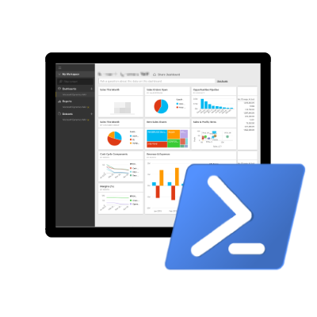

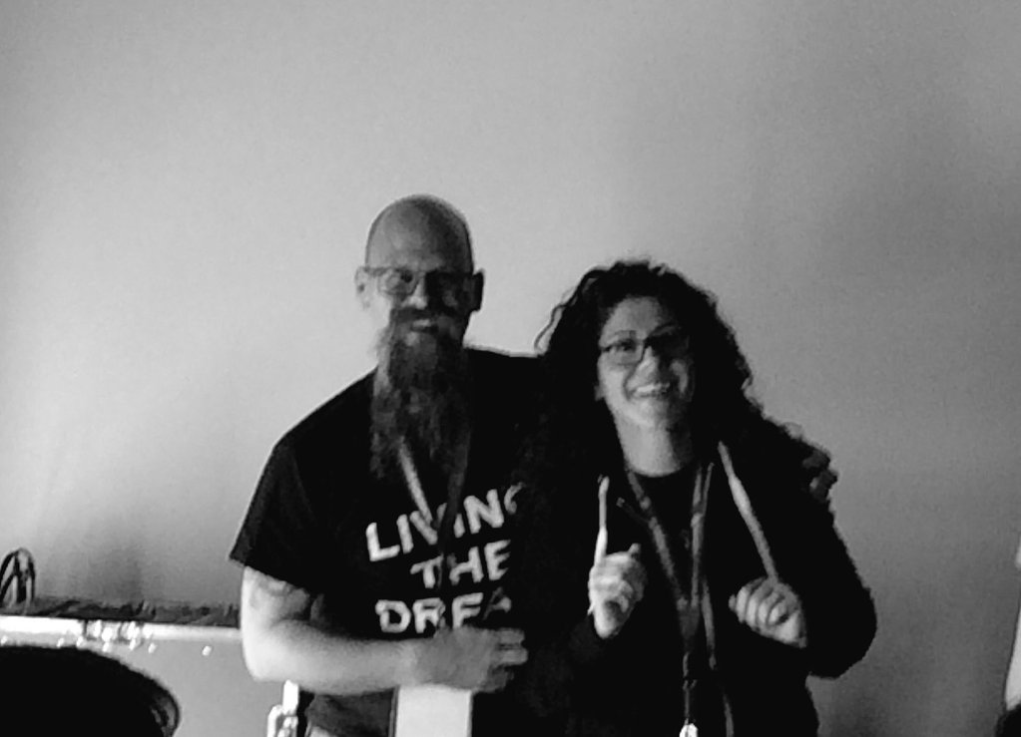
Speaker Questionnaire
Name : Rob
Occupation : DBA, Automator, Do-er, Trainer
Interests : PowerShell, Automation And SQL (PaaS geddit?)
Blog : sqldbawithAbeard.com
Twitter : @sqldbawithbeard
Interesting Fact : Has a Beard. (Still) Plays Cricket, Flys a Drone
Speaker : SQL Saturdays, SQL Relay, PowerShell Conference EU
Community : SQL South West , SQL Saturday Exeter , PowerShell Virtual Chapter Officer, Organiser for PowerShell Conference EU 2017, Lead for dbareports, Major Contributor to dbatools
https://dbatools.io
@psdbatools
https://dbareports.io
@psdbareports

Slide 4
What shall we talk about?
Hundreds or thousands of SQL instances
Install or update default SQL scripts
Ola Hallengren
DBMail set up
SQL Agent Alerts, Operators
Brent Ozar, Adam Mechanic tools
Extended Event Sessions
And anything else you want
@sqldbawithbeard

Slide 5
What shall we talk about?
Testing and Validation
Ensuring we have what we think
Providing reports for management
1st Line support
@sqldbawithbeard

Slide 6
Using T-SQL Scripts
Omnipotent so that they do the same thing whatever the status of the destination
TEST and Test and Test some more
Yup I’m a DBA ☺ Cautious
@sqldbawithbeard

Slide 7
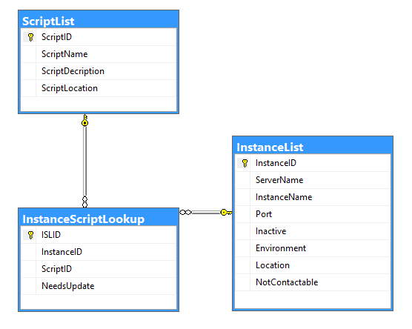

SQL Database like this
Or add it to dbareports ☺
http://dbareports.io
@sqldbawithbeard

Slide 8
Test it with Pester
Pester - https://github.com/pester/Pester
Used for TDD but also for Environmental Validation
You can get started here
https://mcpmag.com/articles/2016/05/19/test-powershell-modules-with-pester.aspx
And see an Active Directory example here
https://pshirwin.wordpress.com/2016/04/08/active-directory-operations-test/
@sqldbawithbeard

Slide 9
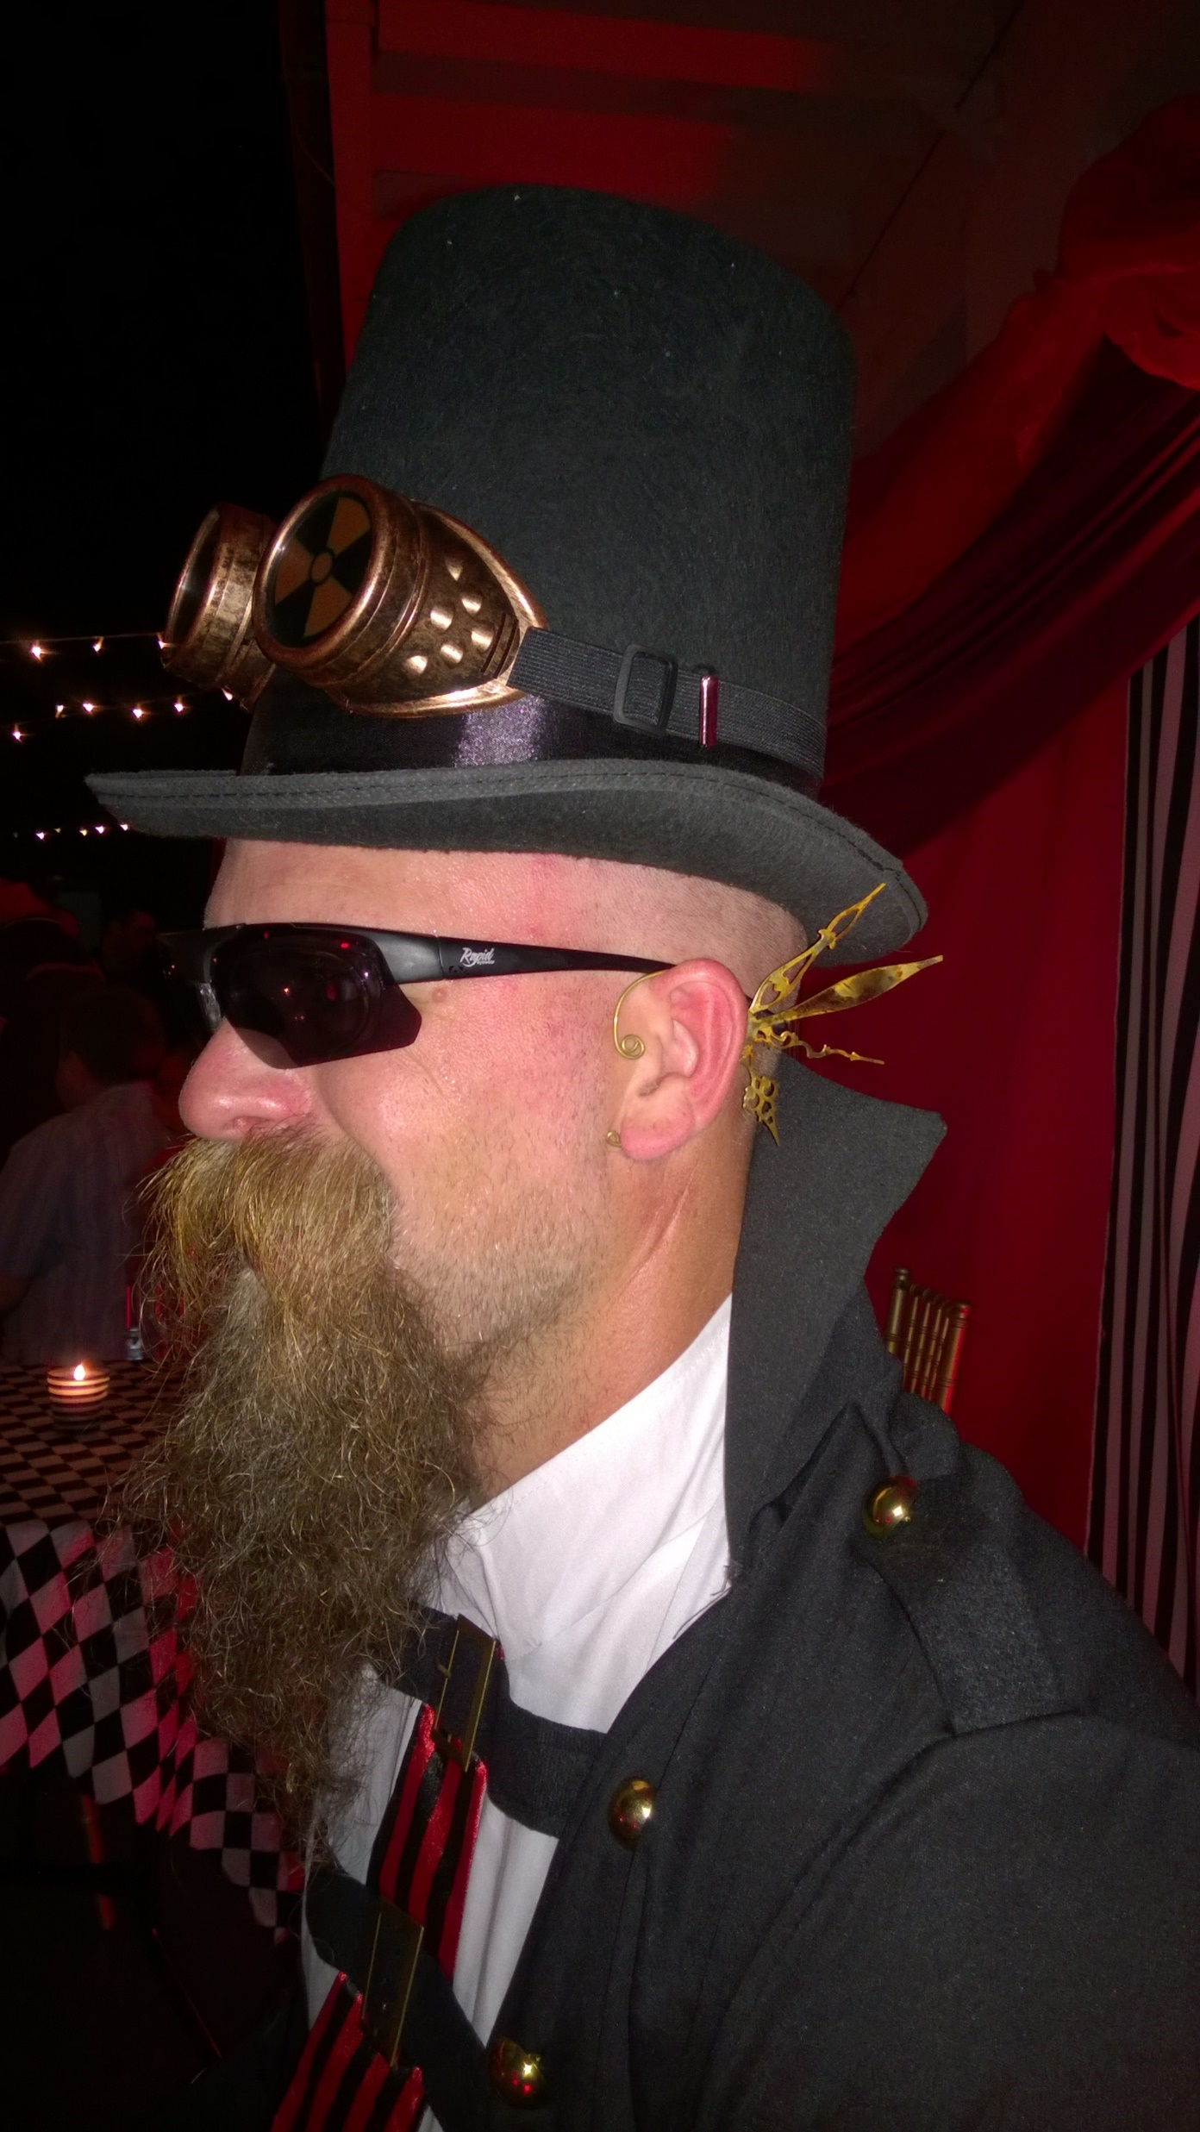
MUST BE TIME
FOR A DEMO

Slide 10

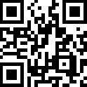
PowerShell VC of PASS
PowerShell for SQL Server
Need to catch up on the changes to SQL PowerShell in 2016?
Recording of July 2016 VC Meeting
Presented by: The PowerShell VC Team
http://sqlps.io/july2016video
On YouTube
sqlps.io/video
• 21 Videos already posted
• New Videos posted every month
• Subscribe to be notified when we post new videos
Wed, Nov 16
Automate Operational Readiness and Validation Testing of SQL Server with PowerShell and Pester Mike Robbins
Join the Conversation
@SQLPowerShell
Trello: sqlps.io/vote Slack: sqlps.io/slack
PowerShell.SQLPASS.org
PowerShell@sqlpass.org
Notes:
Virtual Chapter of Pass – Fast growing, great presenters, videos on Youtube, interacting with Microsoft via Trello,Slack and Connect to bring improvements to the sqlserver module

Slide 11

Questions?
http://www.menshairforum.com/talk/Thread-Beard-Facts-and-Beards-Meme-Facial-Hair-Manly-Knowledge
@sqldbawithbeard
Notes:
Ask A Question

Slide 12

Thank You
@sqldbawithbeard
http://sqldbawithabeard.com
https://uk.linkedin.com/in/robsewellsqldba
mrrobsewell@outlook.com
You have made the beard happy!

